Slide 1
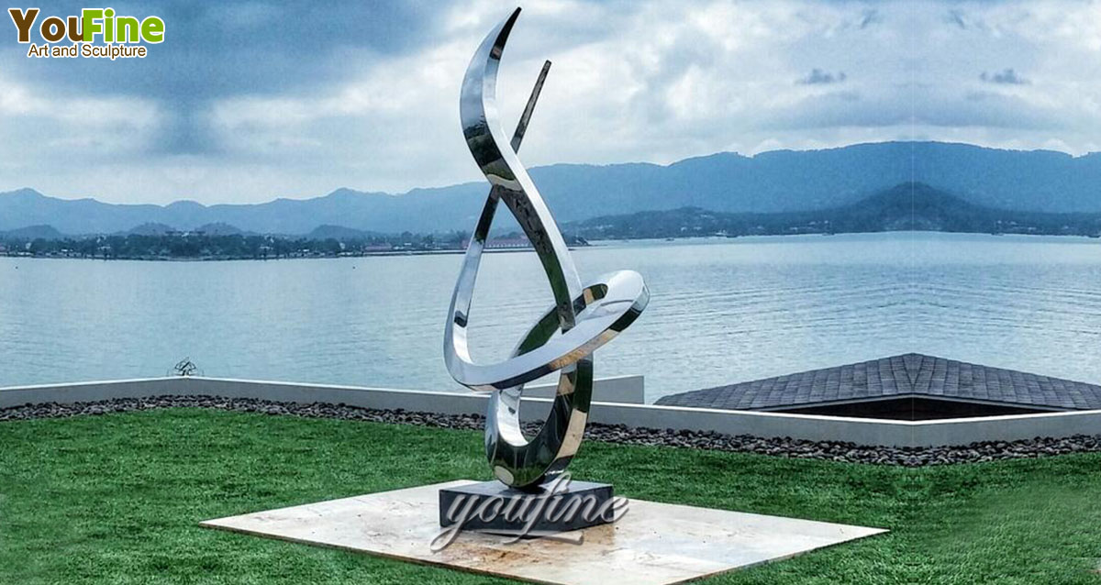
YouFine Art Sculpture
Focus on stainless steel sculpture production for more than 35 years.
Web Site : www.metalssculpture.com
Tell/ WhatsApp : +86- 13938480725 /+86- 18974762151
E-mail:info@you-fine.com / sales@you-fine.com

Slide 2
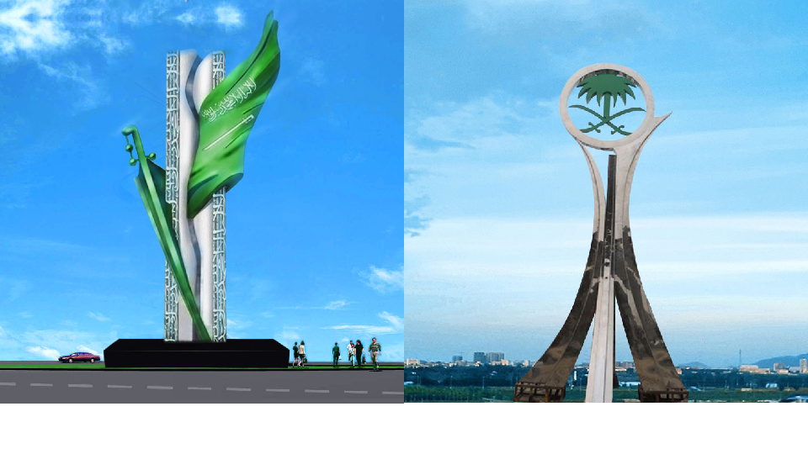
空白演示
YouFine Art Sculpture YouFine Art Sculpture YouFine Art Sculpture
单击输入您的封面副标题
YFSS-1
YFSS-2

Slide 3
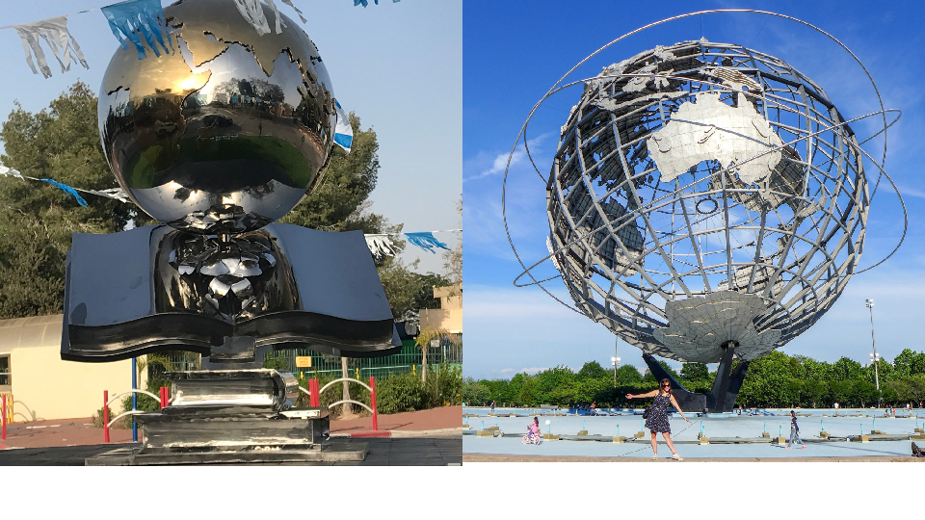
YouFine Art Sculpture YouFine Art Sculpture YouFine Art Sculpture
YFSS-3
YFSS-4

Slide 4
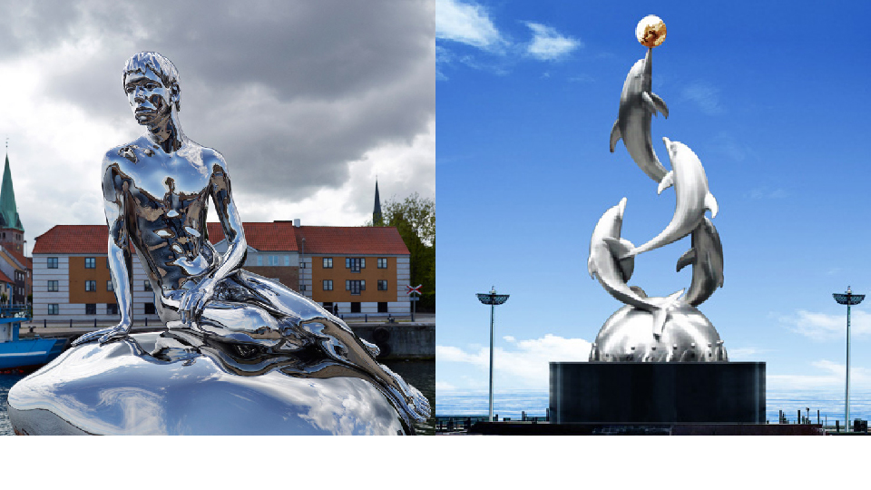
YouFine Art Sculpture YouFine Art Sculpture YouFine Art Sculpture
YFSS-5
YFSS-6

Slide 5
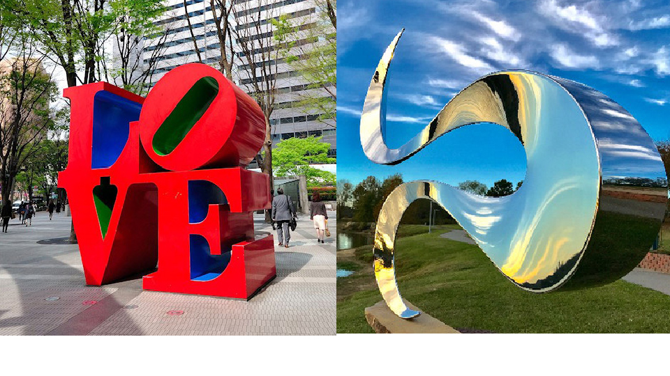
YouFine Art Sculpture YouFine Art Sculpture YouFine Art Sculpture
YFSS-7
YFSS-8

Slide 6
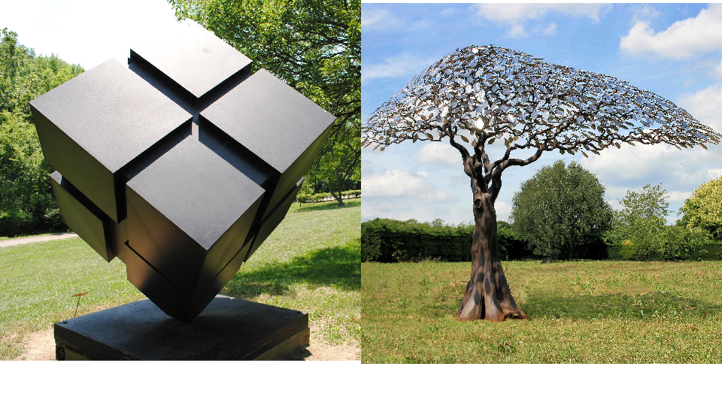
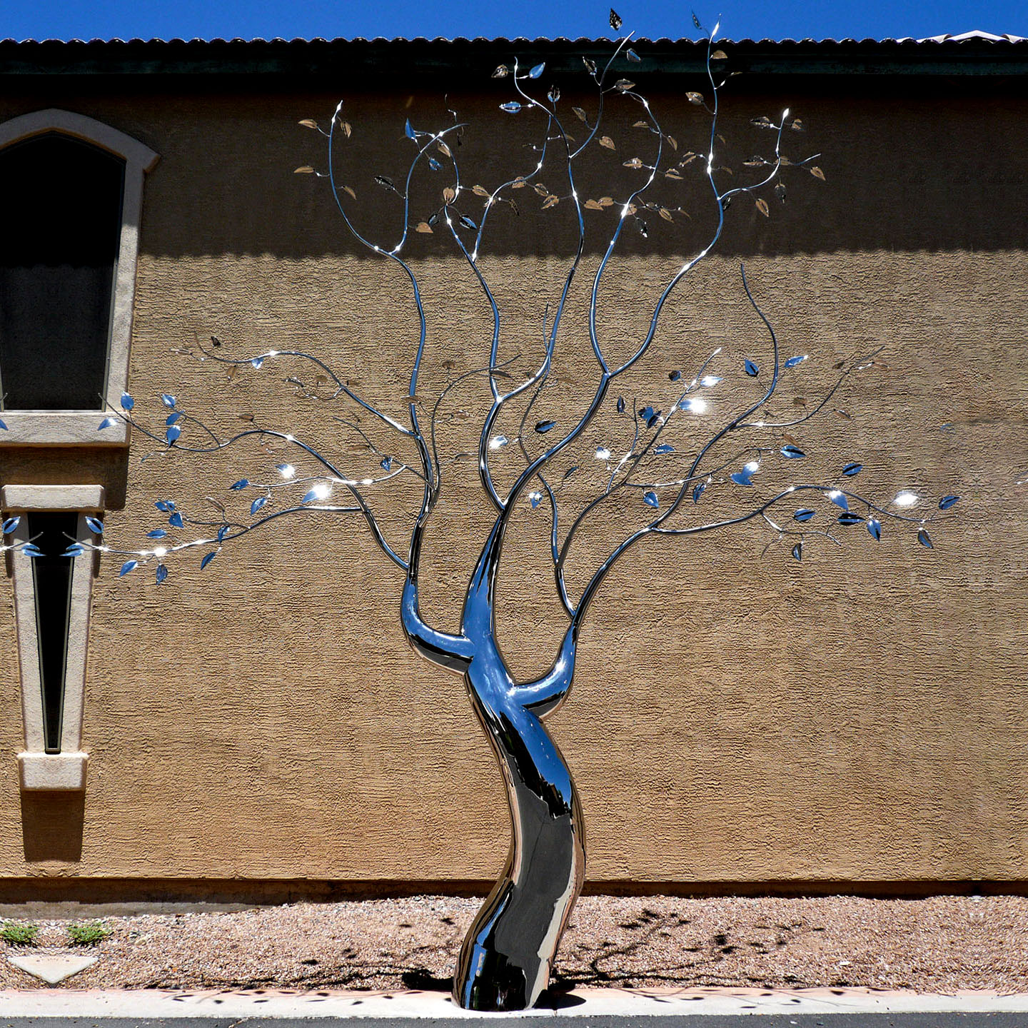
YouFine Art Sculpture YouFine Art Sculpture YouFine Art Sculpture
YFSS-9
YFSS-10

Slide 7
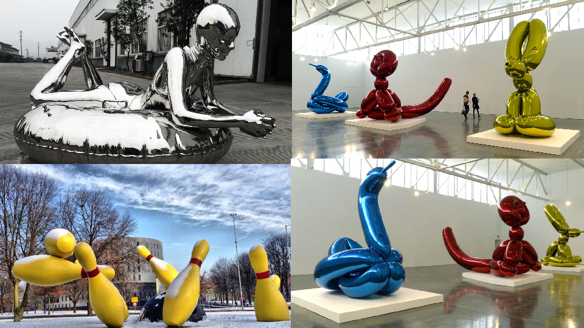
YFSS-11
YouFine Art Sculpture YouFine Art Sculpture YouFine Art Sculpture
YFSS-12
YFSS-13
YFSS-14

Slide 8
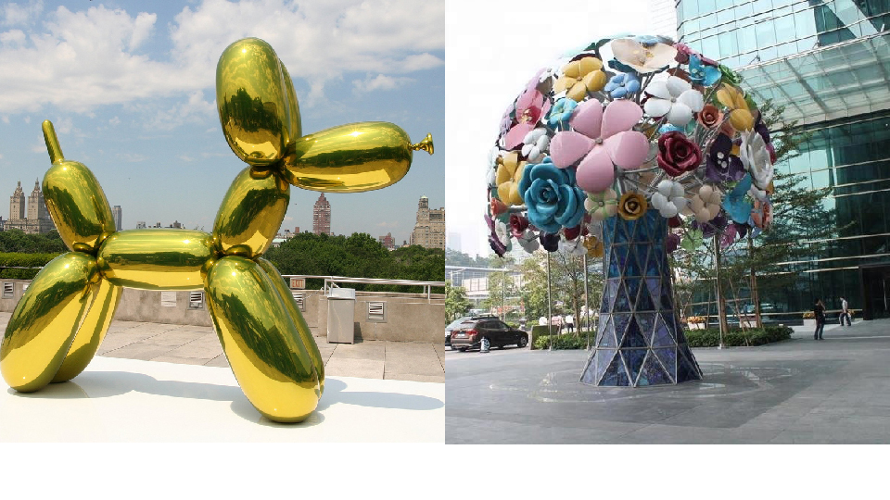
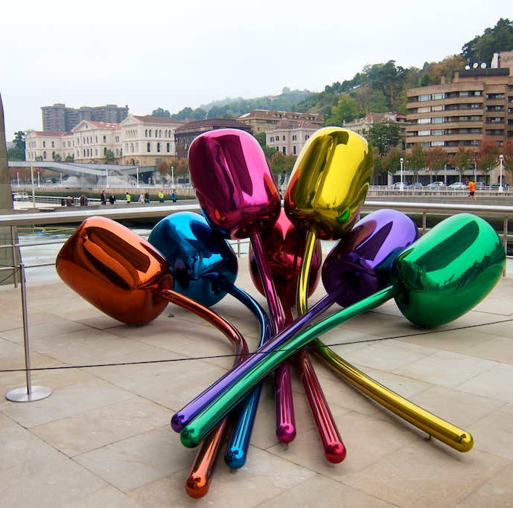
YouFine Art Sculpture YouFine Art Sculpture YouFine Art Sculpture
YFSS-15
YFSS-16

Slide 9
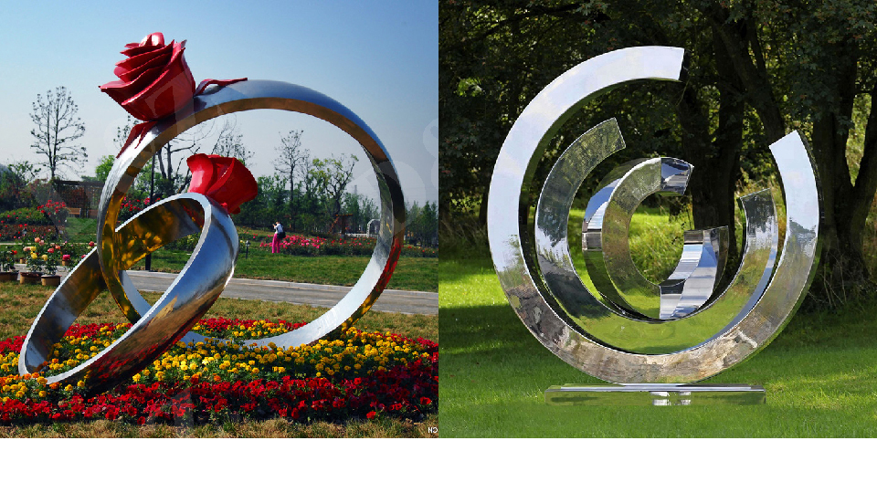
YouFine Art Sculpture YouFine Art Sculpture YouFine Art Sculpture
YFSS-17
YFSS-18

Slide 10
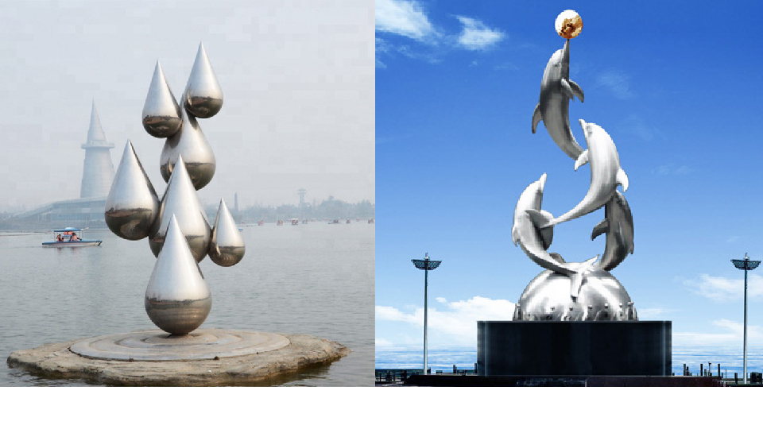
YouFine Art Sculpture YouFine Art Sculpture YouFine Art Sculpture
YFSS-19
YFSS-20

Slide 11
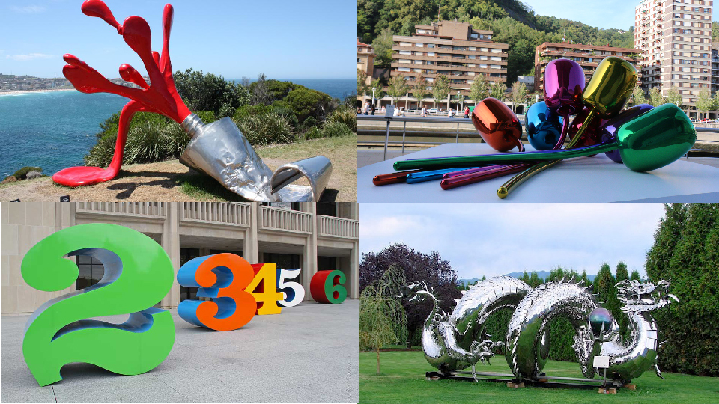
YFSS-21
YouFine Art Sculpture YouFine Art Sculpture YouFine Art Sculpture
YFSS-22
YFSS-23
YFSS-24

Slide 12
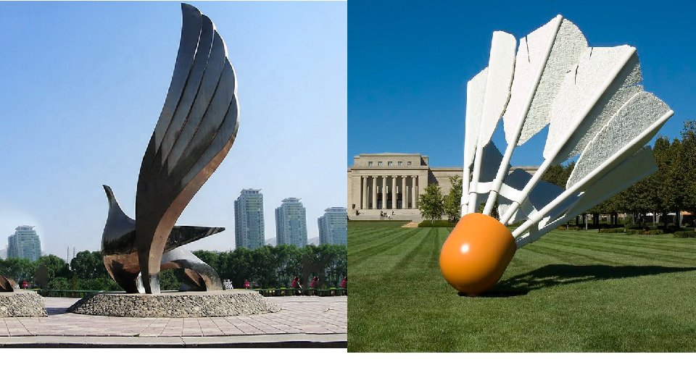
YouFine Art Sculpture YouFine Art Sculpture YouFine Art Sculpture
YFSS-25
YFSS-26

Slide 13
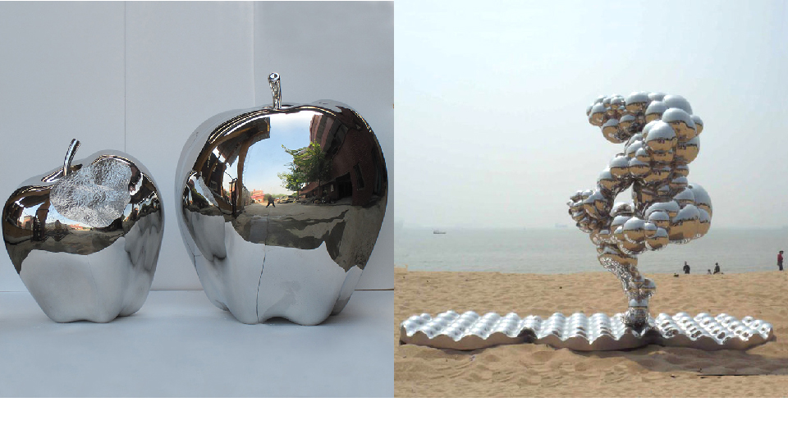
YouFine Art Sculpture YouFine Art Sculpture YouFine Art Sculpture
YFSS-27
YFSS-28

Slide 14
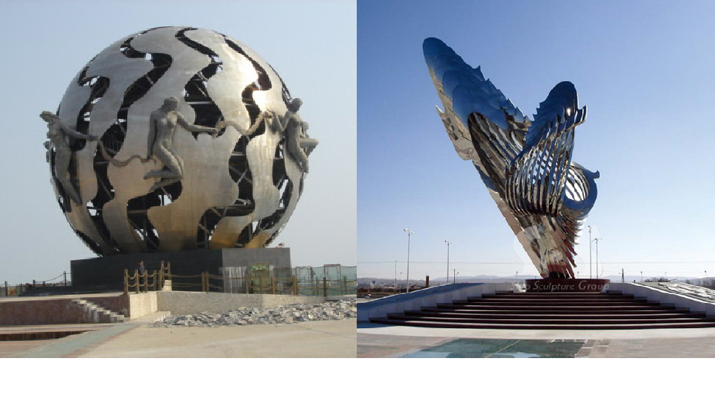
YouFine Art Sculpture YouFine Art Sculpture YouFine Art Sculpture
YFSS-29
YFSS-30

Slide 15
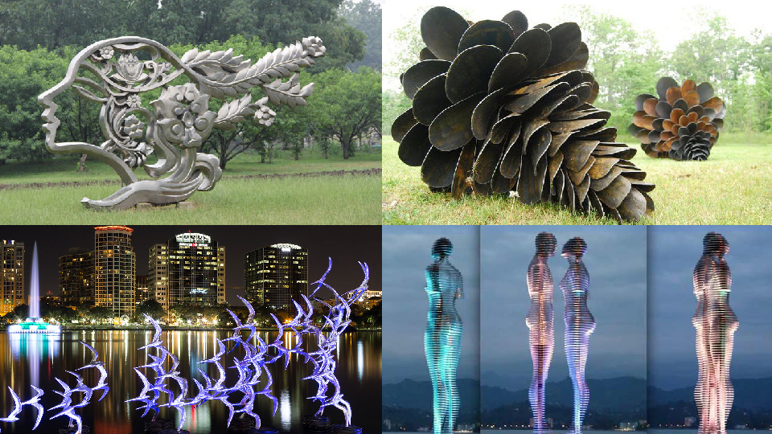
YFSS-31
YouFine Art Sculpture YouFine Art Sculpture YouFine Art Sculpture
YFSS-32
YFSS-33
YFSS-34

Slide 16
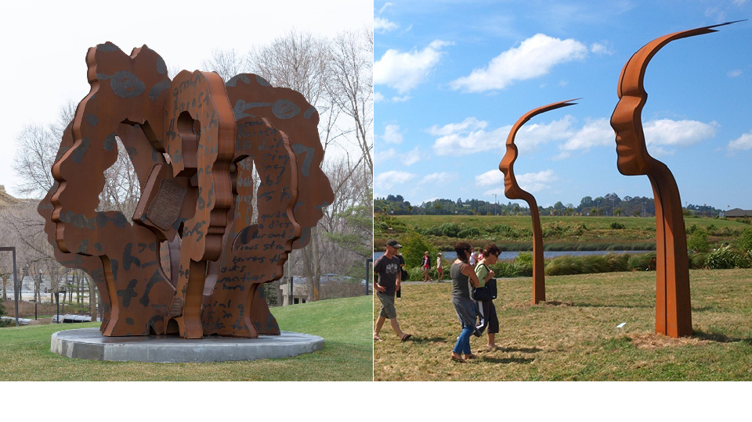
YouFine Art Sculpture YouFine Art Sculpture YouFine Art Sculpture
YFSS-35
YFSS-36

Slide 17
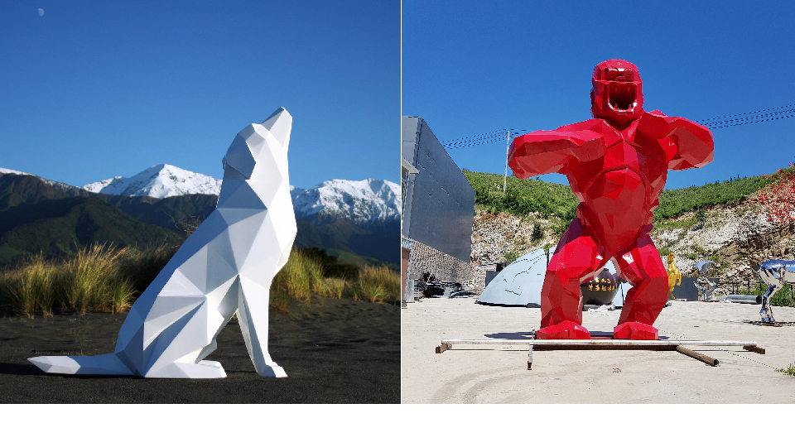
YouFine Art Sculpture YouFine Art Sculpture YouFine Art Sculpture
YFSS-37
YFSS-38

Slide 18
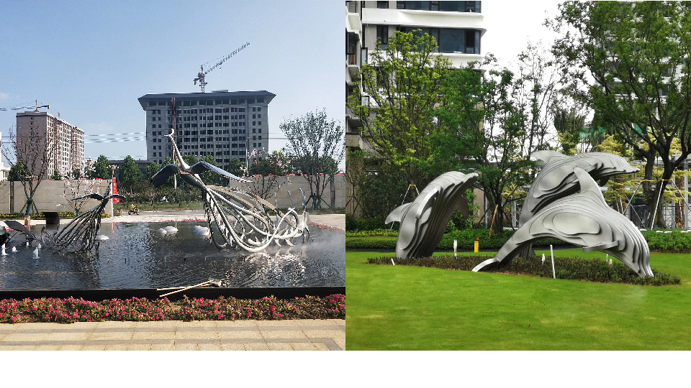
YouFine Art Sculpture YouFine Art Sculpture YouFine Art Sculpture
YFSS-39
YFSS-40

Slide 19
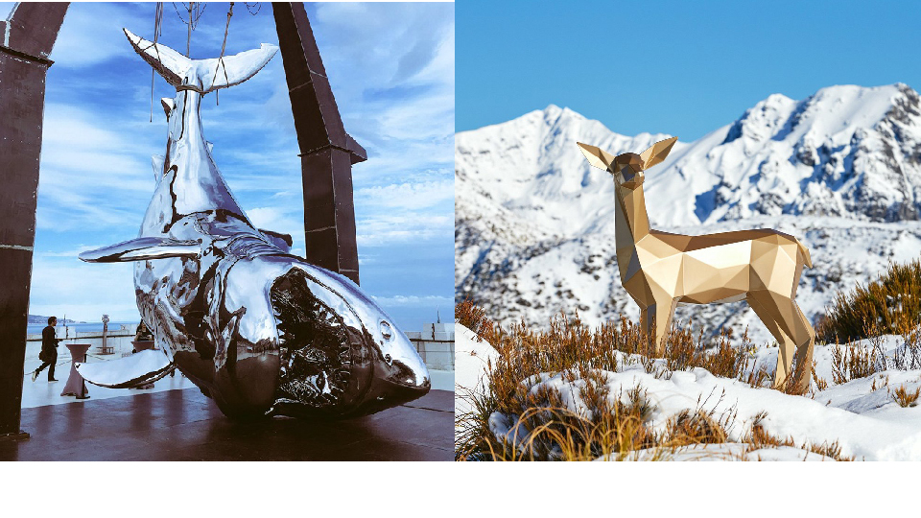
YouFine Art Sculpture YouFine Art Sculpture YouFine Art Sculpture
YFSS-41
YFSS-42

Slide 20
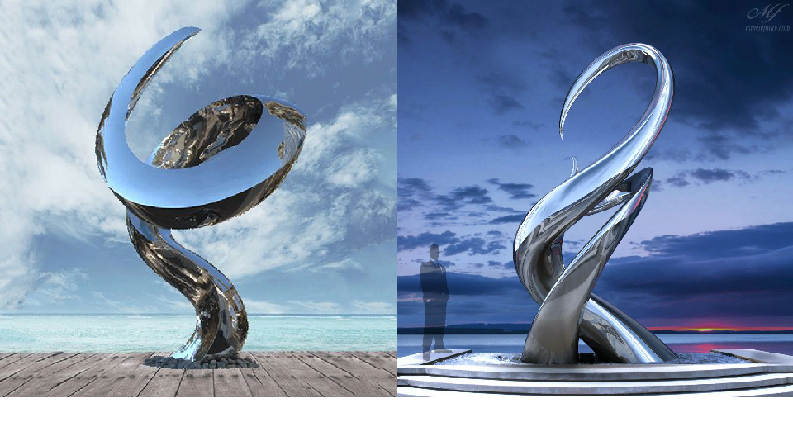
YouFine Art Sculpture YouFine Art Sculpture YouFine Art Sculpture
YFSS-43
YFSS-44

Slide 21
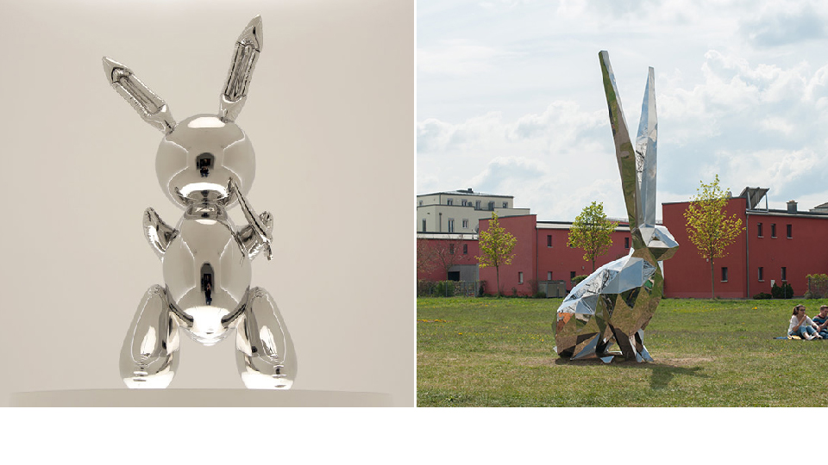
YouFine Art Sculpture YouFine Art Sculpture YouFine Art Sculpture
YFSS-45
YFSS-46

Slide 22
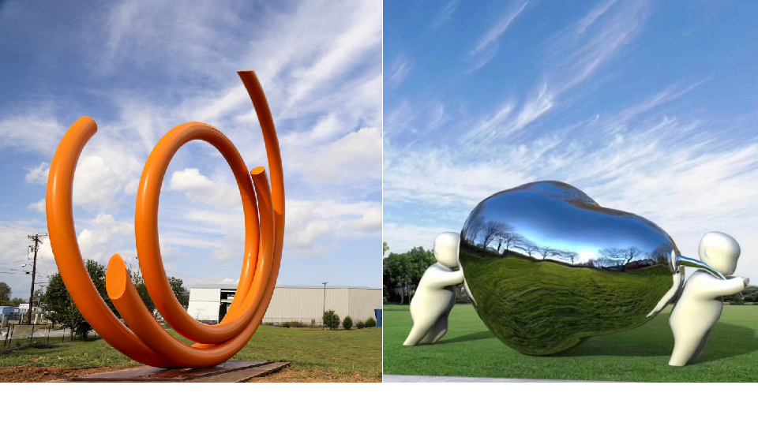
YouFine Art Sculpture YouFine Art Sculpture YouFine Art Sculpture
YFSS-47
YFSS-48

Slide 23
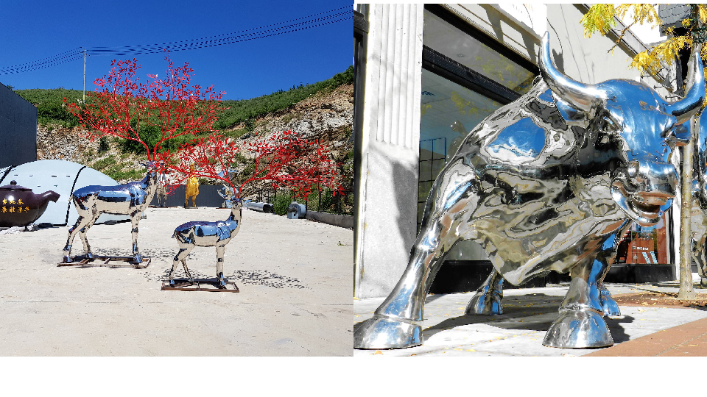
YouFine Art Sculpture YouFine Art Sculpture YouFine Art Sculpture
YFSS-49
YFSS-50

Slide 24
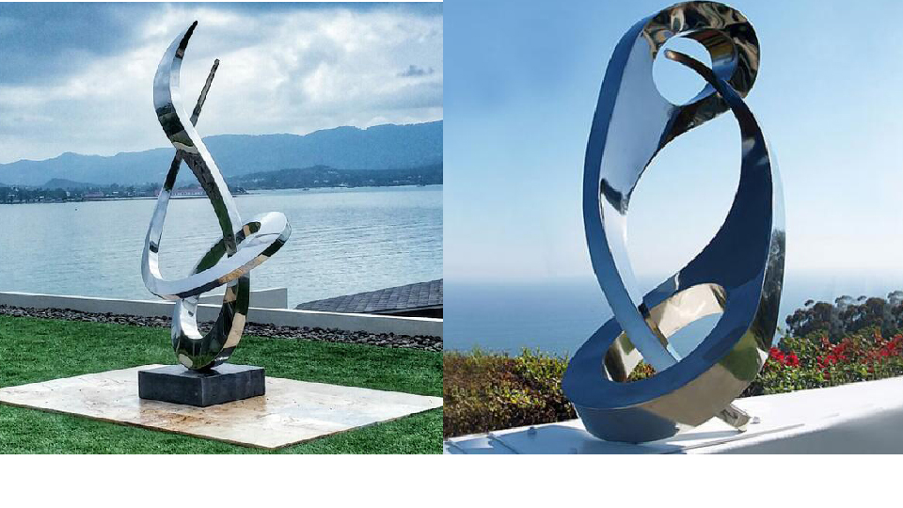
YouFine Art Sculpture YouFine Art Sculpture YouFine Art Sculpture
YFSS-51
YFSS-52

Slide 25
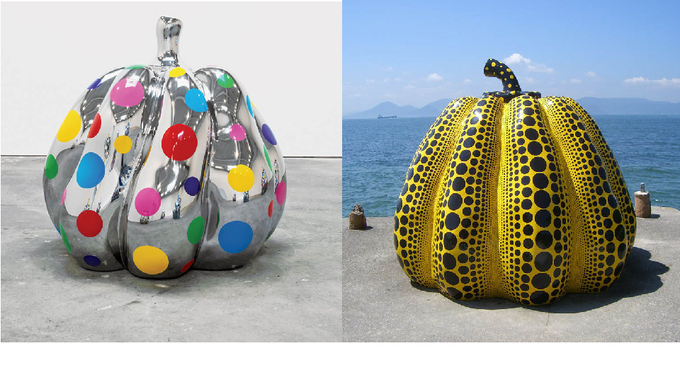
YouFine Art Sculpture YouFine Art Sculpture YouFine Art Sculpture
YFSS-53
YFSS-54

Slide 26
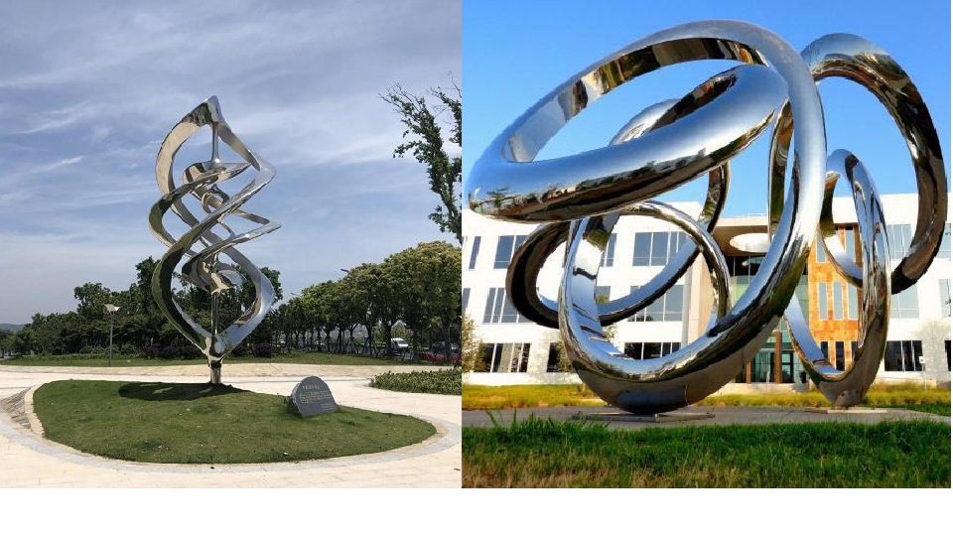
YouFine Art Sculpture YouFine Art Sculpture YouFine Art Sculpture
YFSS-55
YFSS-56

Slide 27
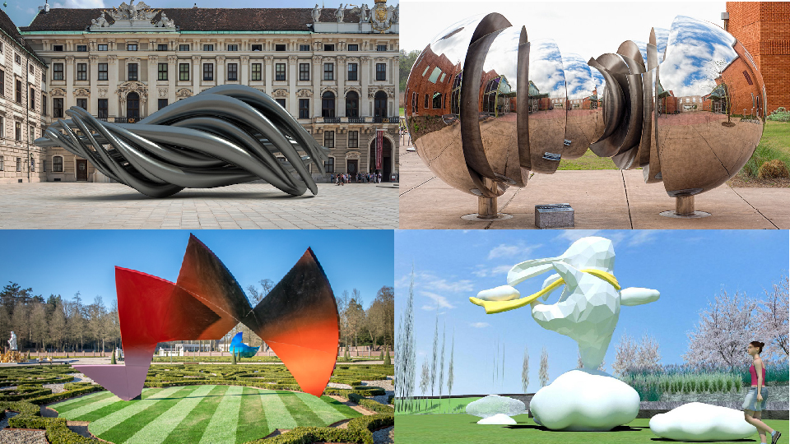
YFSS-57
YouFine Art Sculpture YouFine Art Sculpture YouFine Art Sculpture
YFSS-58
YFSS-59
YFSS-60

Slide 28
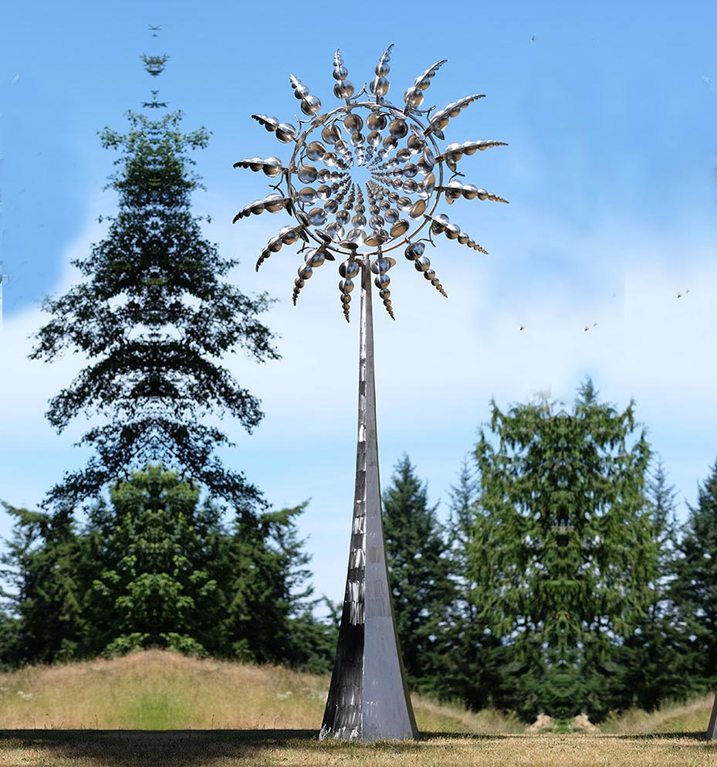
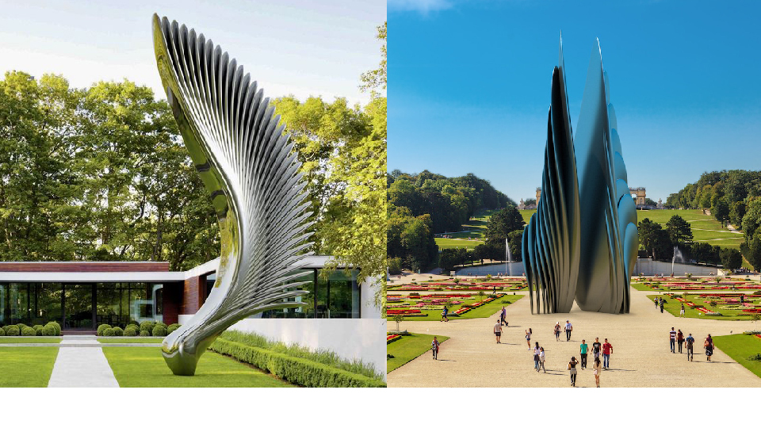
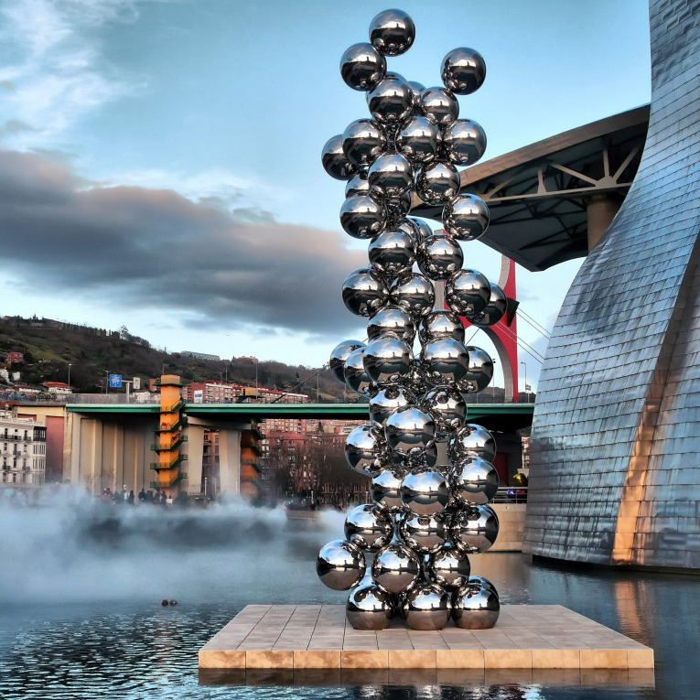
YouFine Art Sculpture YouFine Art Sculpture YouFine Art Sculpture
YouFine Art Sculpture YouFine Art Sculpture YouFine Art Sculpture
YFSS-61
YFSS-62

Slide 29
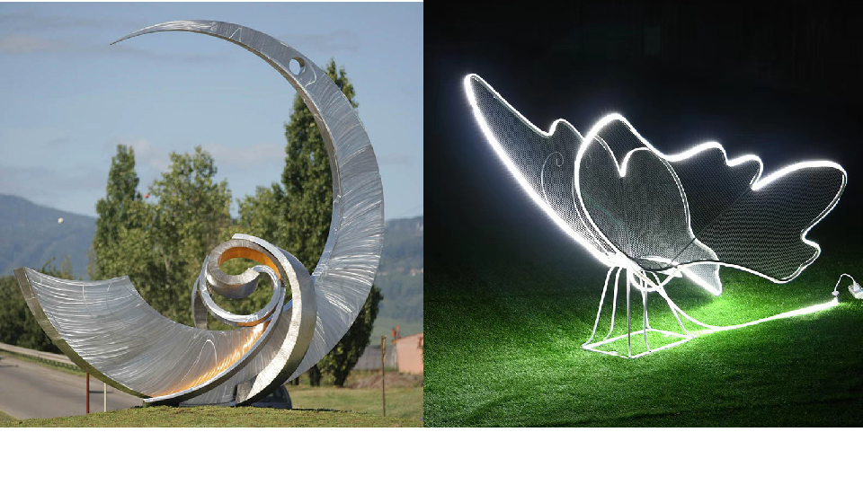
YouFine Art Sculpture YouFine Art Sculpture YouFine Art Sculpture
YFSS-63
YFSS-64

Slide 30
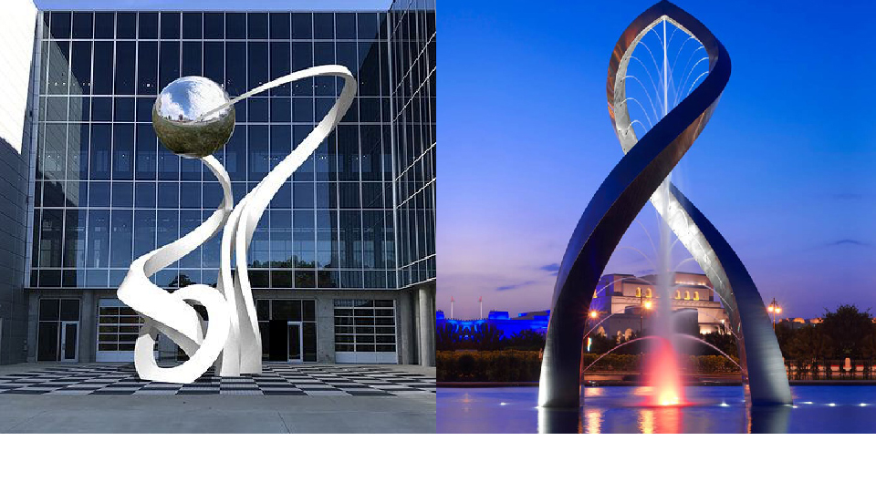
YouFine Art Sculpture YouFine Art Sculpture YouFine Art Sculpture
YFSS-65
YFSS-66

Slide 31
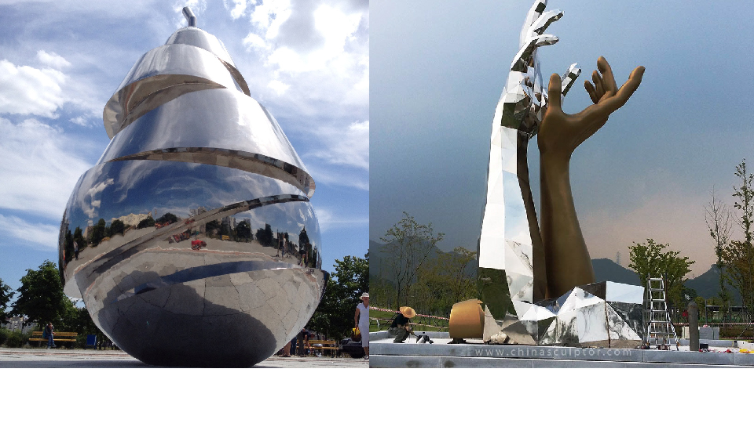
YouFine Art Sculpture YouFine Art Sculpture YouFine Art Sculpture
YFSS-67
YFSS-68

Slide 32
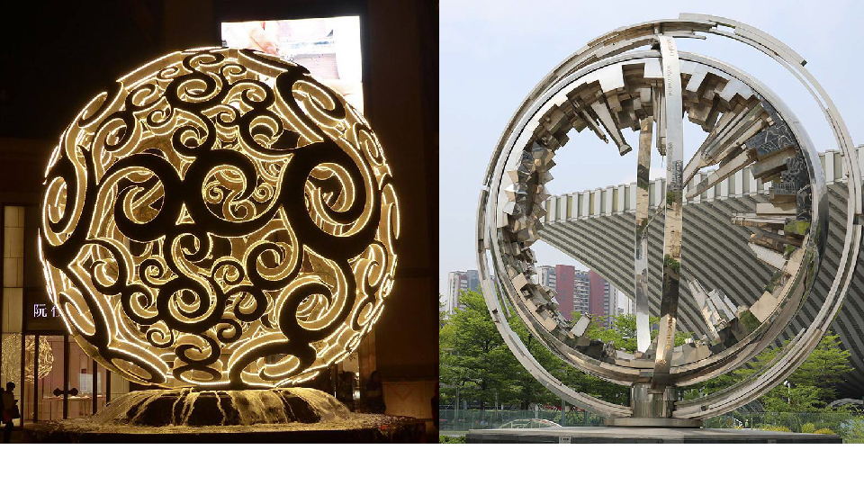
YouFine Art Sculpture YouFine Art Sculpture YouFine Art Sculpture
YFSS-69
YFSS-70

Slide 33
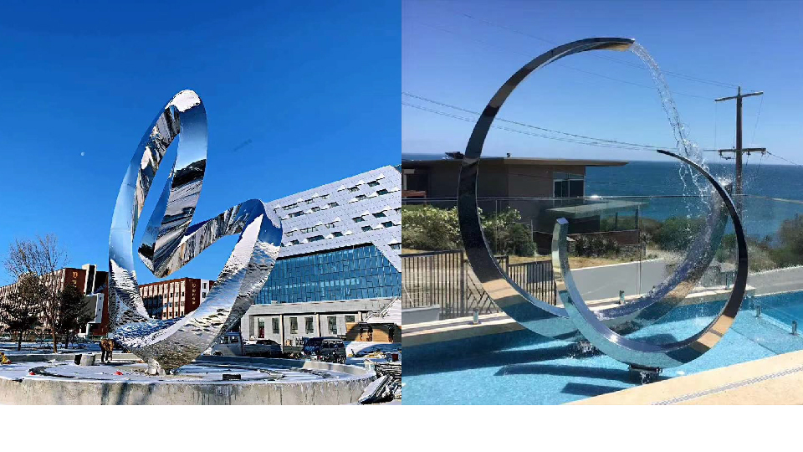
YouFine Art Sculpture YouFine Art Sculpture YouFine Art Sculpture
YFSS-71
YFSS-72

Slide 34
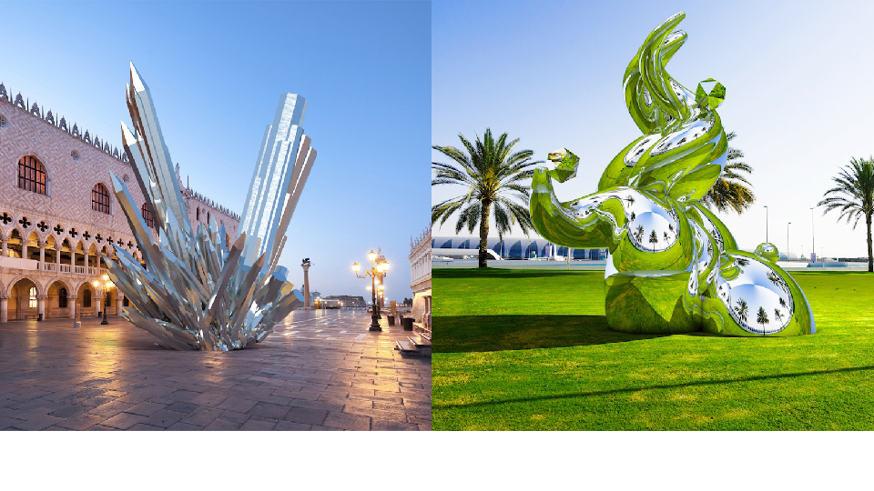
YouFine Art Sculpture YouFine Art Sculpture YouFine Art Sculpture
YFSS-73
YFSS-74

Slide 35
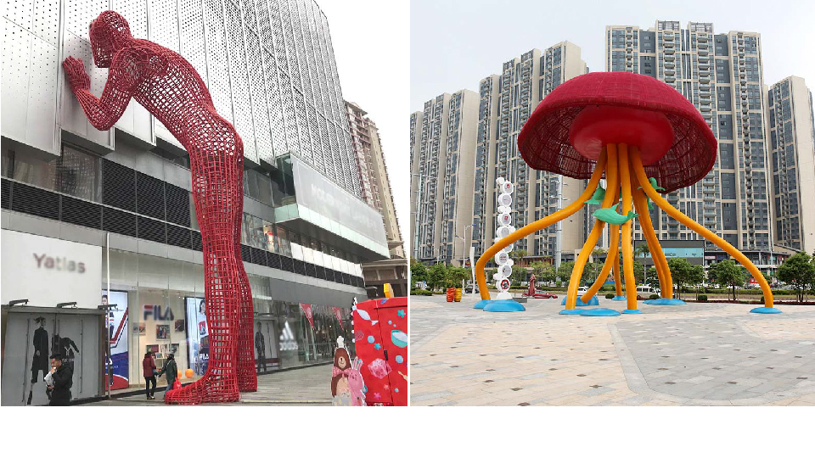
YouFine Art Sculpture YouFine Art Sculpture YouFine Art Sculpture
YFSS-75
YFSS-76

Slide 36
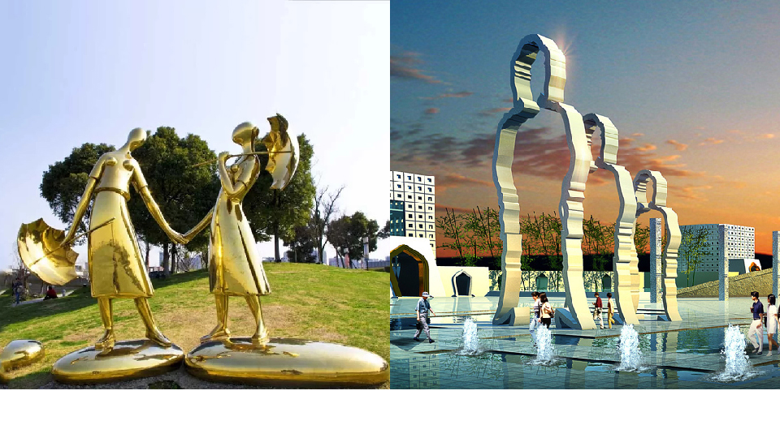
YouFine Art Sculpture YouFine Art Sculpture YouFine Art Sculpture
YFSS-77
YFSS-78

Slide 37
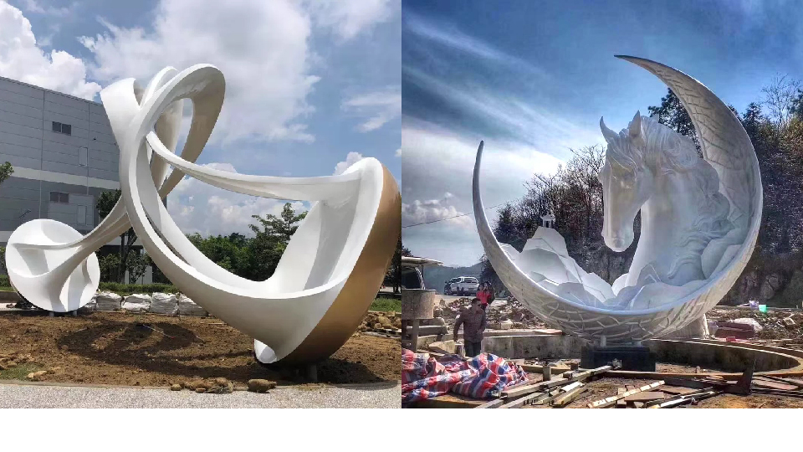
YouFine Art Sculpture YouFine Art Sculpture YouFine Art Sculpture
YFSS-79
YFSS-80

Slide 38
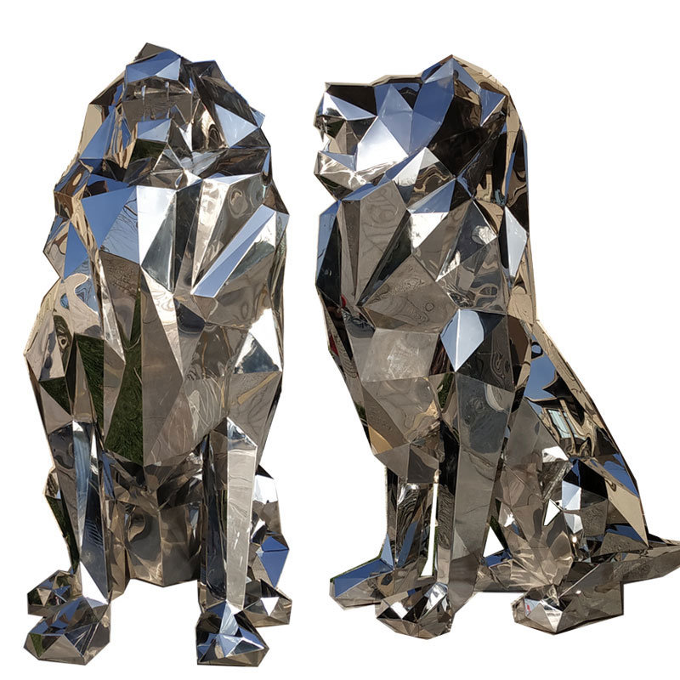
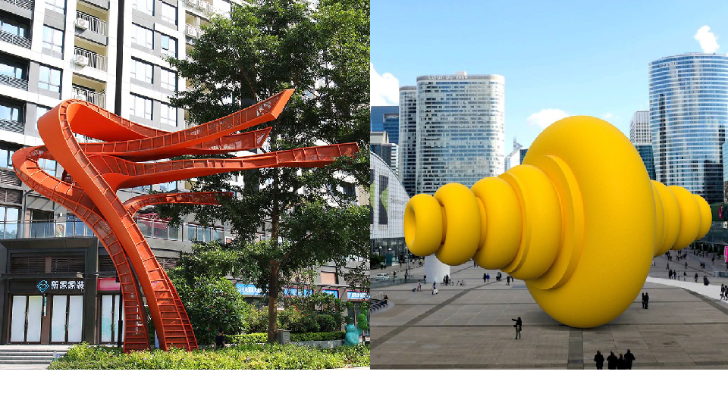
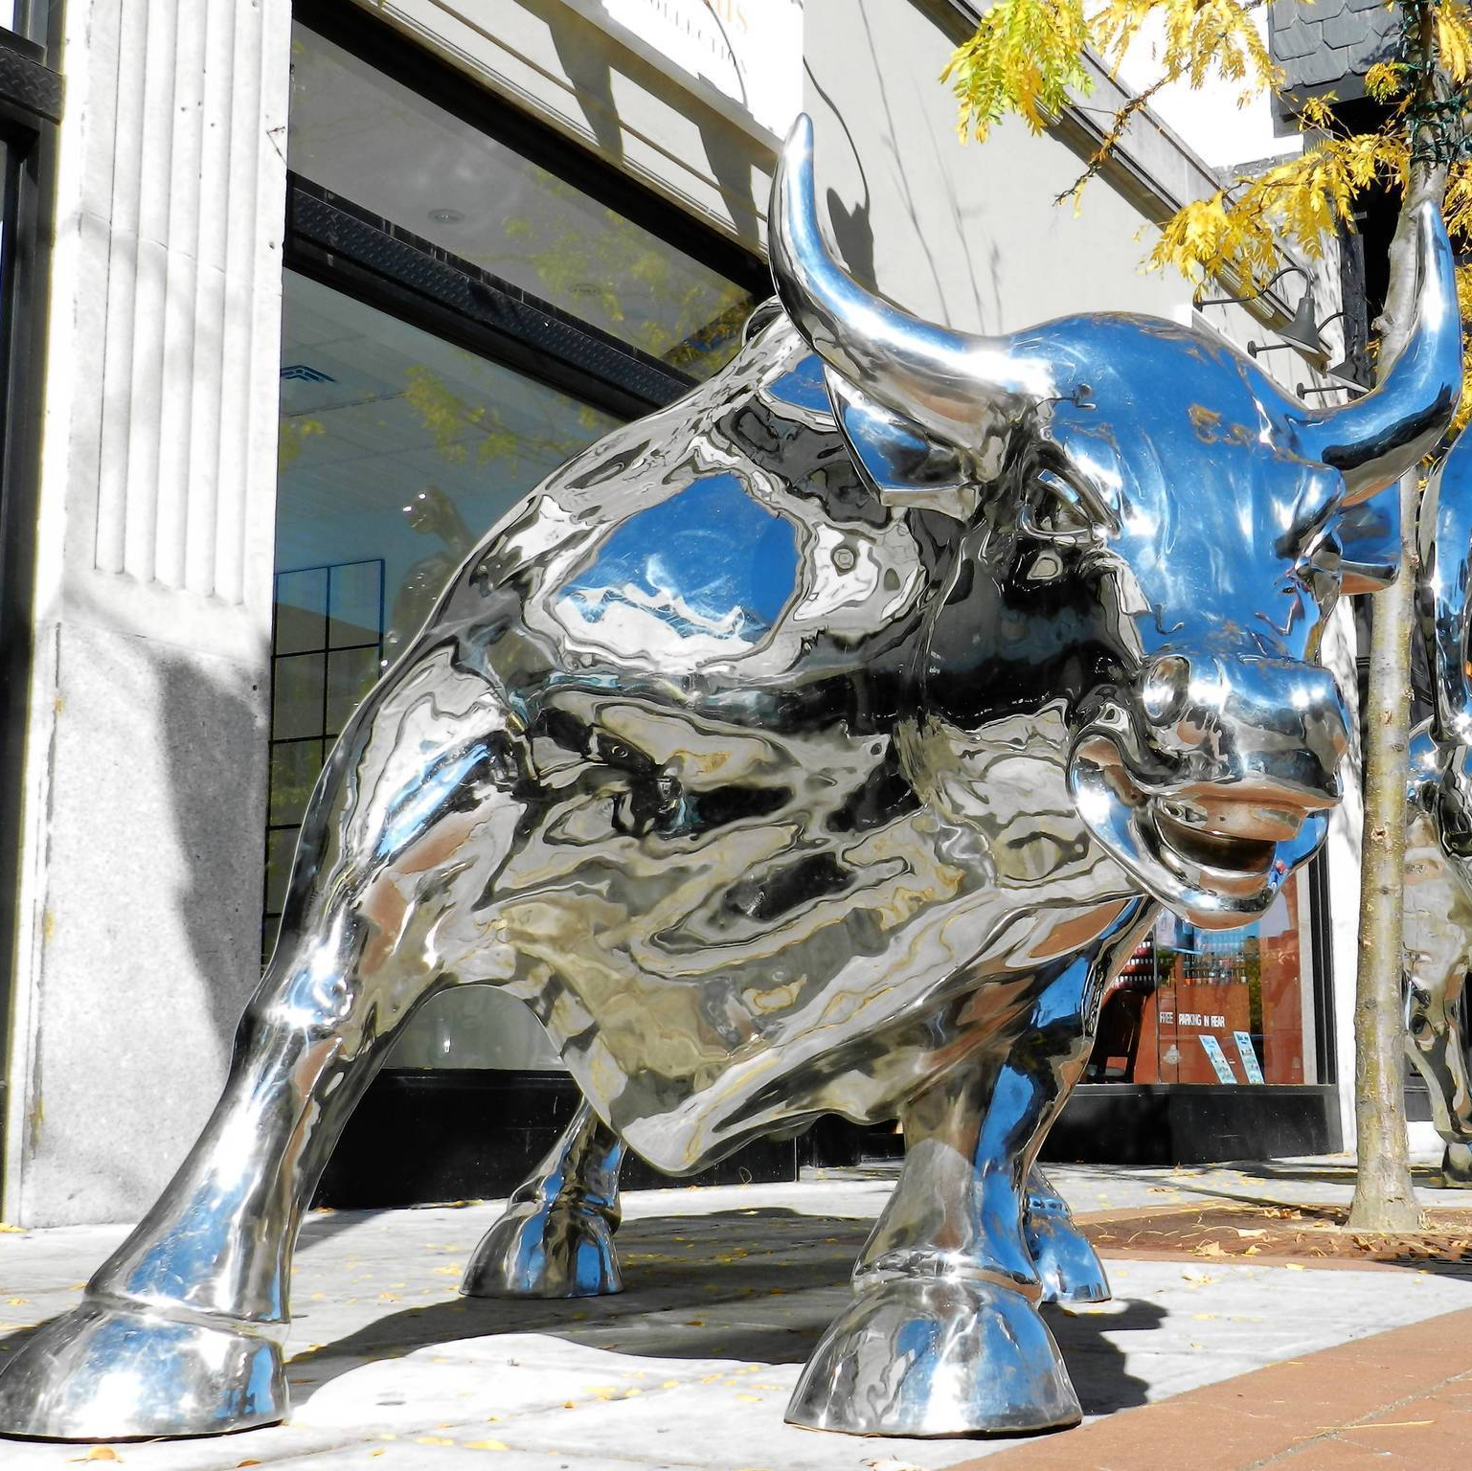
YouFine Art Sculpture YouFine Art Sculpture YouFine Art Sculpture
YFSS-81
YFSS-82

Slide 39
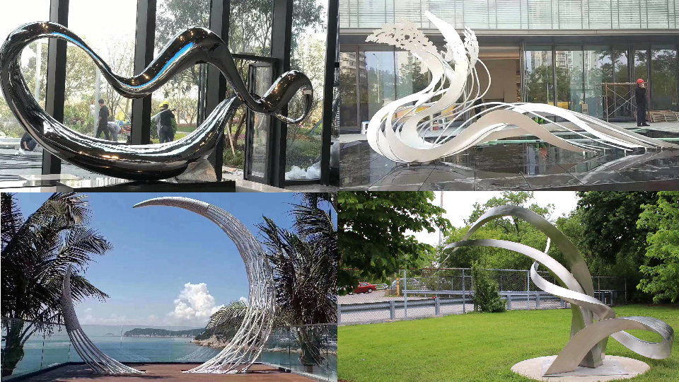
YFSS-83
YouFine Art Sculpture YouFine Art Sculpture YouFine Art Sculpture
YFSS-84
YFSS-85
YFSS-86

Slide 40
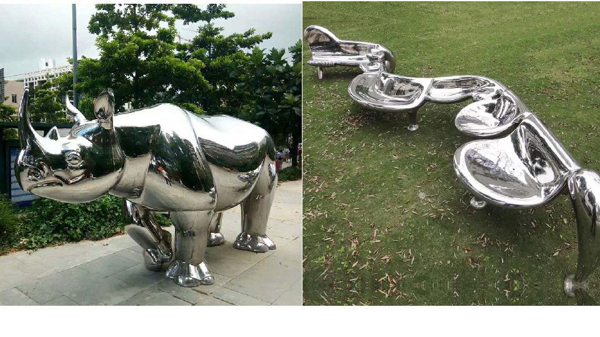
YouFine Art Sculpture YouFine Art Sculpture YouFine Art Sculpture
YFSS-87
YFSS-88

Slide 41
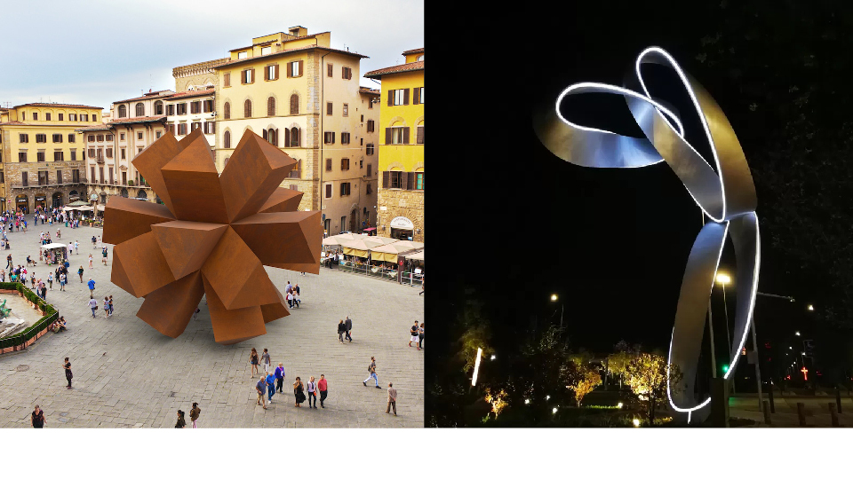
YouFine Art Sculpture YouFine Art Sculpture YouFine Art Sculpture
YFSS-89
YFSS-90

Slide 42
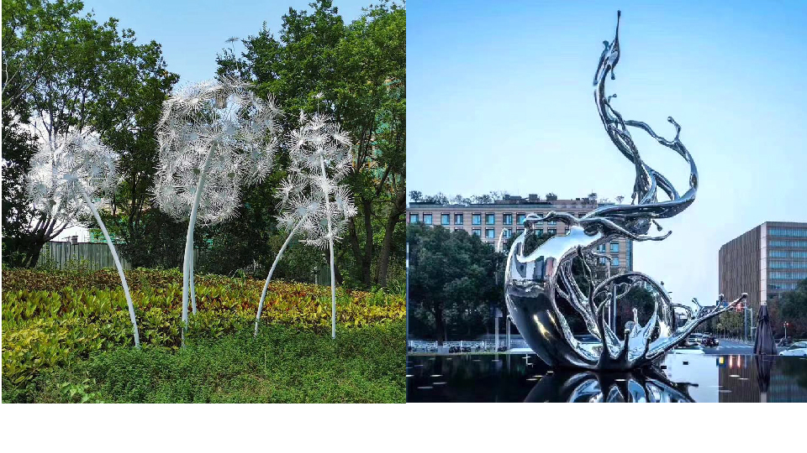
YouFine Art Sculpture YouFine Art Sculpture YouFine Art Sculpture
YFSS-91
YFSS-92

Slide 43
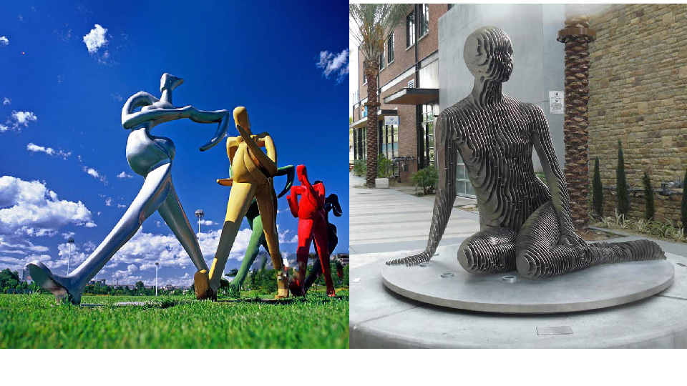
YouFine Art Sculpture YouFine Art Sculpture YouFine Art Sculpture
YFSS-93
YFSS-94

Slide 44
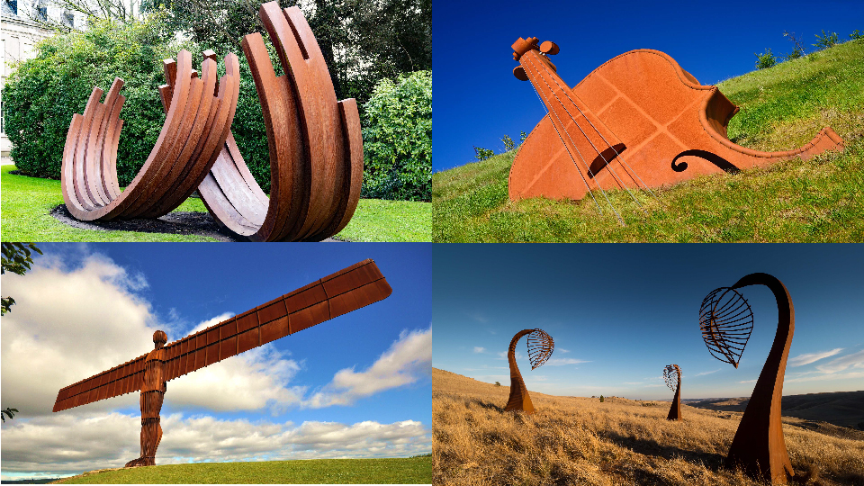
YFSS-95
YouFine Art Sculpture YouFine Art Sculpture YouFine Art Sculpture
YFSS-96
YFSS-97
YFSS-98

Slide 45
YFSS-99
YouFine Art Sculpture YouFine Art Sculpture YouFine Art Sculpture
YFSS-100
YFSS-101
YFSS-102

Slide 46
YFSS-103
YouFine Art Sculpture YouFine Art Sculpture YouFine Art Sculpture
YFSS-104
YFSS-105
YFSS-106

Slide 47
YFSS-107
YouFine Art Sculpture YouFine Art Sculpture YouFine Art Sculpture
YFSS-108
YFSS-109
YFSS-110

Slide 48
YouFine Art Sculpture YouFine Art Sculpture YouFine Art Sculpture
YFSS-111
YFSS-112

Slide 49
YouFine Art Sculpture YouFine Art Sculpture YouFine Art Sculpture
YFSS-113
YFSS-114

Slide 50
YouFine Art Sculpture YouFine Art Sculpture YouFine Art Sculpture
YFSS-115
YFSS-116

Slide 51
YouFine Art Sculpture
Focus on stainless steel sculpture production for more than 35 years.
Web Site : www.metalssculpture.com
Tell/ WhatsApp : +86- 13938480725 /+86- 18974762151
E-mail:info@you-fine.com / sales@you-fine.com

